Slide 1

SMART INDIA HACKATHON 2026
TITLE PAGE
Problem Statement ID – SIH1431
Problem Statement Title – Online personalized learning remediation/tutoring tool. Search for best teacher for specific topics.
Theme – Smart Education
PS Category – Software
Team ID – [Registered Team ID]
Team Name – AUTHENTIX
Proposed Solution – VIDYA AI: Cognitive Remediation & Semantic Teacher Discovery Engine

Slide 2
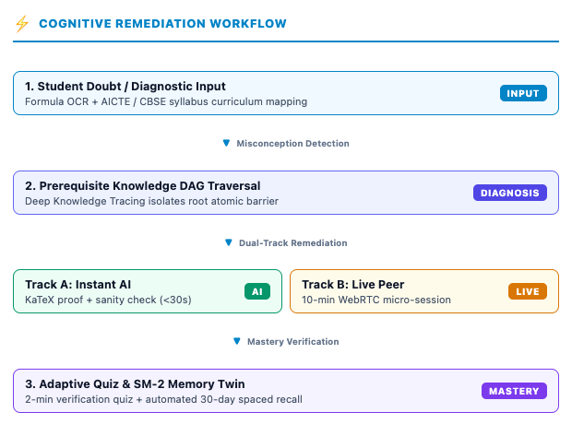
PROPOSED SOLUTION: VIDYA AI
AUTHENTIX
VIDYA AI: Cognitive Remediation & Teacher Discovery
Closed-Loop Cognitive Architecture: Integrates real-time student misconception diagnosis with semantic, topic-specific teacher discovery.
Knowledge DAG Tracing: Traverses a Prerequisite Knowledge DAG to isolate the exact atomic barrier (e.g. Eigenvalue trace rule, Recursion base-cases) behind failed questions.
Deterministic Step-by-Step Proofs: Instant KaTeX derivations backed by automated mathematical sanity assertions with zero hallucination.
On-Demand Micro-Tutoring: Eliminates predatory ₹50,000 annual packages by offering 10-minute 1-on-1 peer doubt clearing sessions for pennies.
Cognitive Memory Twin: SuperMemo SM-2 spaced repetition scheduler reinforces concepts before decay, lifting 30-day retention from 20% to >75%.

Slide 3
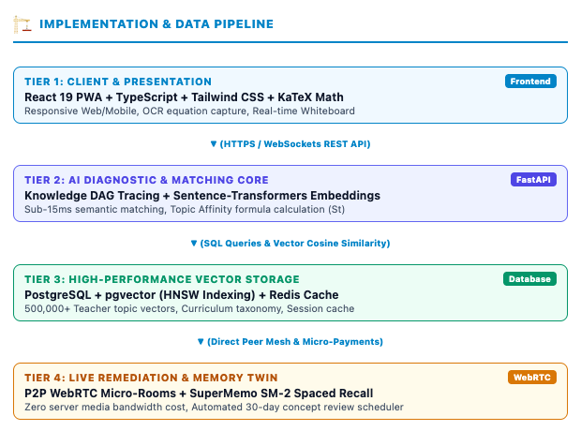
TECHNICAL APPROACH
AUTHENTIX
Technology Stack & Implementation Architecture
Frontend & Interaction: React 19 PWA, TypeScript, Tailwind CSS, KaTeX LaTeX math parser, and interactive HTML5 canvas whiteboard.
AI & Diagnostics Core: Deep Knowledge Tracing (DKT), Sentence-Transformers (all-MiniLM-L6-v2) for dense topic embeddings, and Gemini 1.5 Flash.
Vector DB & Data Tier: PostgreSQL with pgvector (HNSW indexing for sub-15ms semantic searches), Redis session cache, and syllabus DAG.
Zero-Cost Live Media: Peer-to-Peer WebRTC audio/video mesh and synchronized whiteboard with zero central relay bandwidth overhead.
Deterministic Assertions: Automated algebraic consistency checks prevent model hallucinations before rendering to the student.

Slide 4
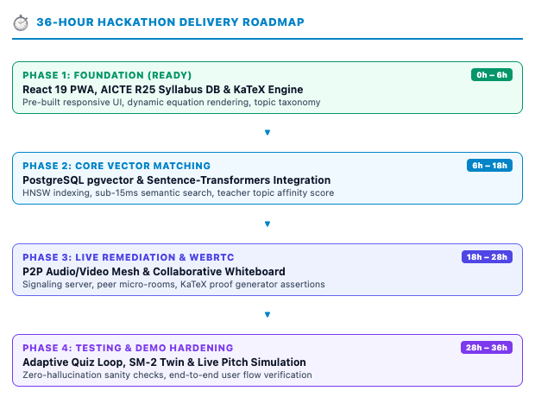
FEASIBILITY AND VIABILITY
AUTHENTIX
Feasibility Analysis & Risk Mitigation
High 36-Hour Feasibility: Core UI, AICTE R25 syllabus database, KaTeX math renderer, and quiz engine are already built and tested.
Zero Cost Burden: 100% open-source software (HuggingFace embeddings, PostgreSQL pgvector, WebRTC) ensures free access without server costs.
Hardware Inclusivity: Ultra-lightweight Progressive Web App (PWA) operates smoothly on entry-level Android devices and 2G/3G networks.
Risk 1 & Mitigation (AI Hallucinations): Automated deterministic math sanity assertions (e.g. Trace = Sum of Eigenvalues) verify steps.
Risk 2 & Mitigation (Tutor Fraud): Topic badges are tied strictly to objective student quiz pass rates, preventing fake reviews.
Risk 3 & Mitigation (Scalability): Direct P2P WebRTC architecture handles 100,000+ simultaneous sessions without media server bandwidth costs.

Slide 5
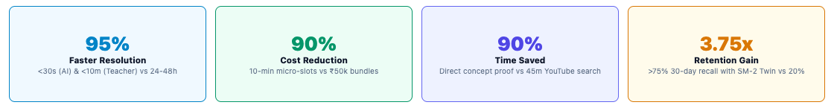
IMPACT AND BENEFITS
AUTHENTIX
Demographic & Socio-Economic Reach
30+ Crore Students: Democratizes elite tier-1 personalized tutoring for rural and government school learners across India.
Vernacular Pedagogy: Multi-lingual remediation in Hindi, Bengali, Tamil, Telugu, and Marathi ensures linguistic inclusion.
Economic Liberation: Replaces predatory ₹50,000 annual course packages with free AI derivations and ₹10 micro-tutoring slots.
Confidence Restoration: Immediate root-cause diagnosis prevents academic dropouts by turning fear of subjects into mastery.
National Policy Alignment (NEP 2020 & SDGs)
NEP 2020 Section 4.3: Directly implements experiential, adaptive learning and formative competency-based assessments.
NEP 2020 Section 23: Champions educational technology integration and AI-driven personalized remedial support.
PARAKH NCERT Compliance: Bridges learning gaps mapped against national performance standards and AICTE guidelines.
UN SDG 4 & 10: Furthers Quality Education and Reduced Inequalities through equitable, accessible learning technology.

Slide 6
RESEARCH AND REFERENCES
AUTHENTIX
Academic Research & Algorithmic Foundations
Deep Knowledge Tracing (DKT): Piech, C., Bassen, J., et al. (Stanford University), NeurIPS. Recurrent neural networks for modeling student knowledge over time.
Cognitive Memory & Spaced Repetition: Wozniak, P., Optimization of Learning: Two Components of Long-Term Memory (SuperMemo SM-2 Algorithm).
Dense Semantic Embeddings: Reimers, N. & Gurevych, I., Sentence-BERT: Sentence Embeddings using Siamese BERT-Networks (EMNLP).
Bloom's 2-Sigma Problem: Bloom, B. S., The 2 Sigma Problem: The Search for Methods of Group Instruction as Effective as One-to-One Tutoring.
Knowledge Graph Remediation: Chen, P., et al., Prerequisite Concept Graphs for Automated Adaptive Learning Path Generation.
Government Directives & Curriculum Benchmarks
National Education Policy (NEP 2020): Ministry of Education, Government of India. Sections 4.3 & 23 on digital pedagogy and adaptive remediation.
AICTE Model Curriculum (R25 Guidelines): Higher technical education engineering syllabus taxonomy and course outcome standards.
PARAKH NCERT Standards: National Assessment Centre guidelines on student diagnostics, holistic progress cards, and remedial feedback loops.
AISHE Survey (Ministry of Education): Baseline data on student-to-faculty ratios (24:1 national average) justifying automated peer tutoring.
DIKSHA & SWAYAM PRABHA: National digital infrastructure interoperability frameworks for open digital educational content.

